Slide 1
Day 1 – Azure Machine Learning Fundamentals
BRK01 – Azure Machine Learning overview & architecture (25 min)
BRK02 – DEMO: The Azure Machine Learning workspace (15 min)
BRK03 – Introducing the Data Science process (30 min)
ACT01 – MENTI: Organizing and working in a data science team
BRK04 – Responsible AI and Machine Learning (30 min)
LAB01 – Training and deploying a model in Azure Machine Learning
BRK05 – Using compute resources in Azure Machine Learning (30 min)
BRK06 – Securing an Azure Machine Learning workspace (60 min)
ACT02 – DISCUSS: Establishing a securing baseline for Azure Machine Learning

Slide 2
BRK01 – Azure Machine Learning Overview & Architecture
<Presenter name>
<Presenter title>

Slide 3
Agenda
Machine Learning on Azure
Azure Machine Learning
The Advanced Analytics Pattern in Azure
The Model Deployment Pattern in Azure
Machine Learning Model Interoperability
Tools for Machine Learning

Slide 4








Machine Learning on Azure
Domain specific pretrained models
To simplify solution development
…
Vision
Speech
Language
Web search
Decision
Familiar data science tools
To simplify model development
Visual Studio Code
Azure Notebooks
Jupyter
Command line
Visual Studio Code
Popular frameworks
To build advanced deep learning solutions
PyTorch
TensorFlow
Scikit-Learn
ONNX
PyTorch
Productive services
To empower data science and development teams
Azure Machine Learning
Azure Databricks
Machine Learning VMs
Azure Machine Learning
Powerful infrastructure
To accelerate deep learning
CPU
GPU
FPGA
CPU
From the Intelligent Cloud to the Intelligent Edge

Slide 5
Azure Machine Learning
Notebooks

Slide 6









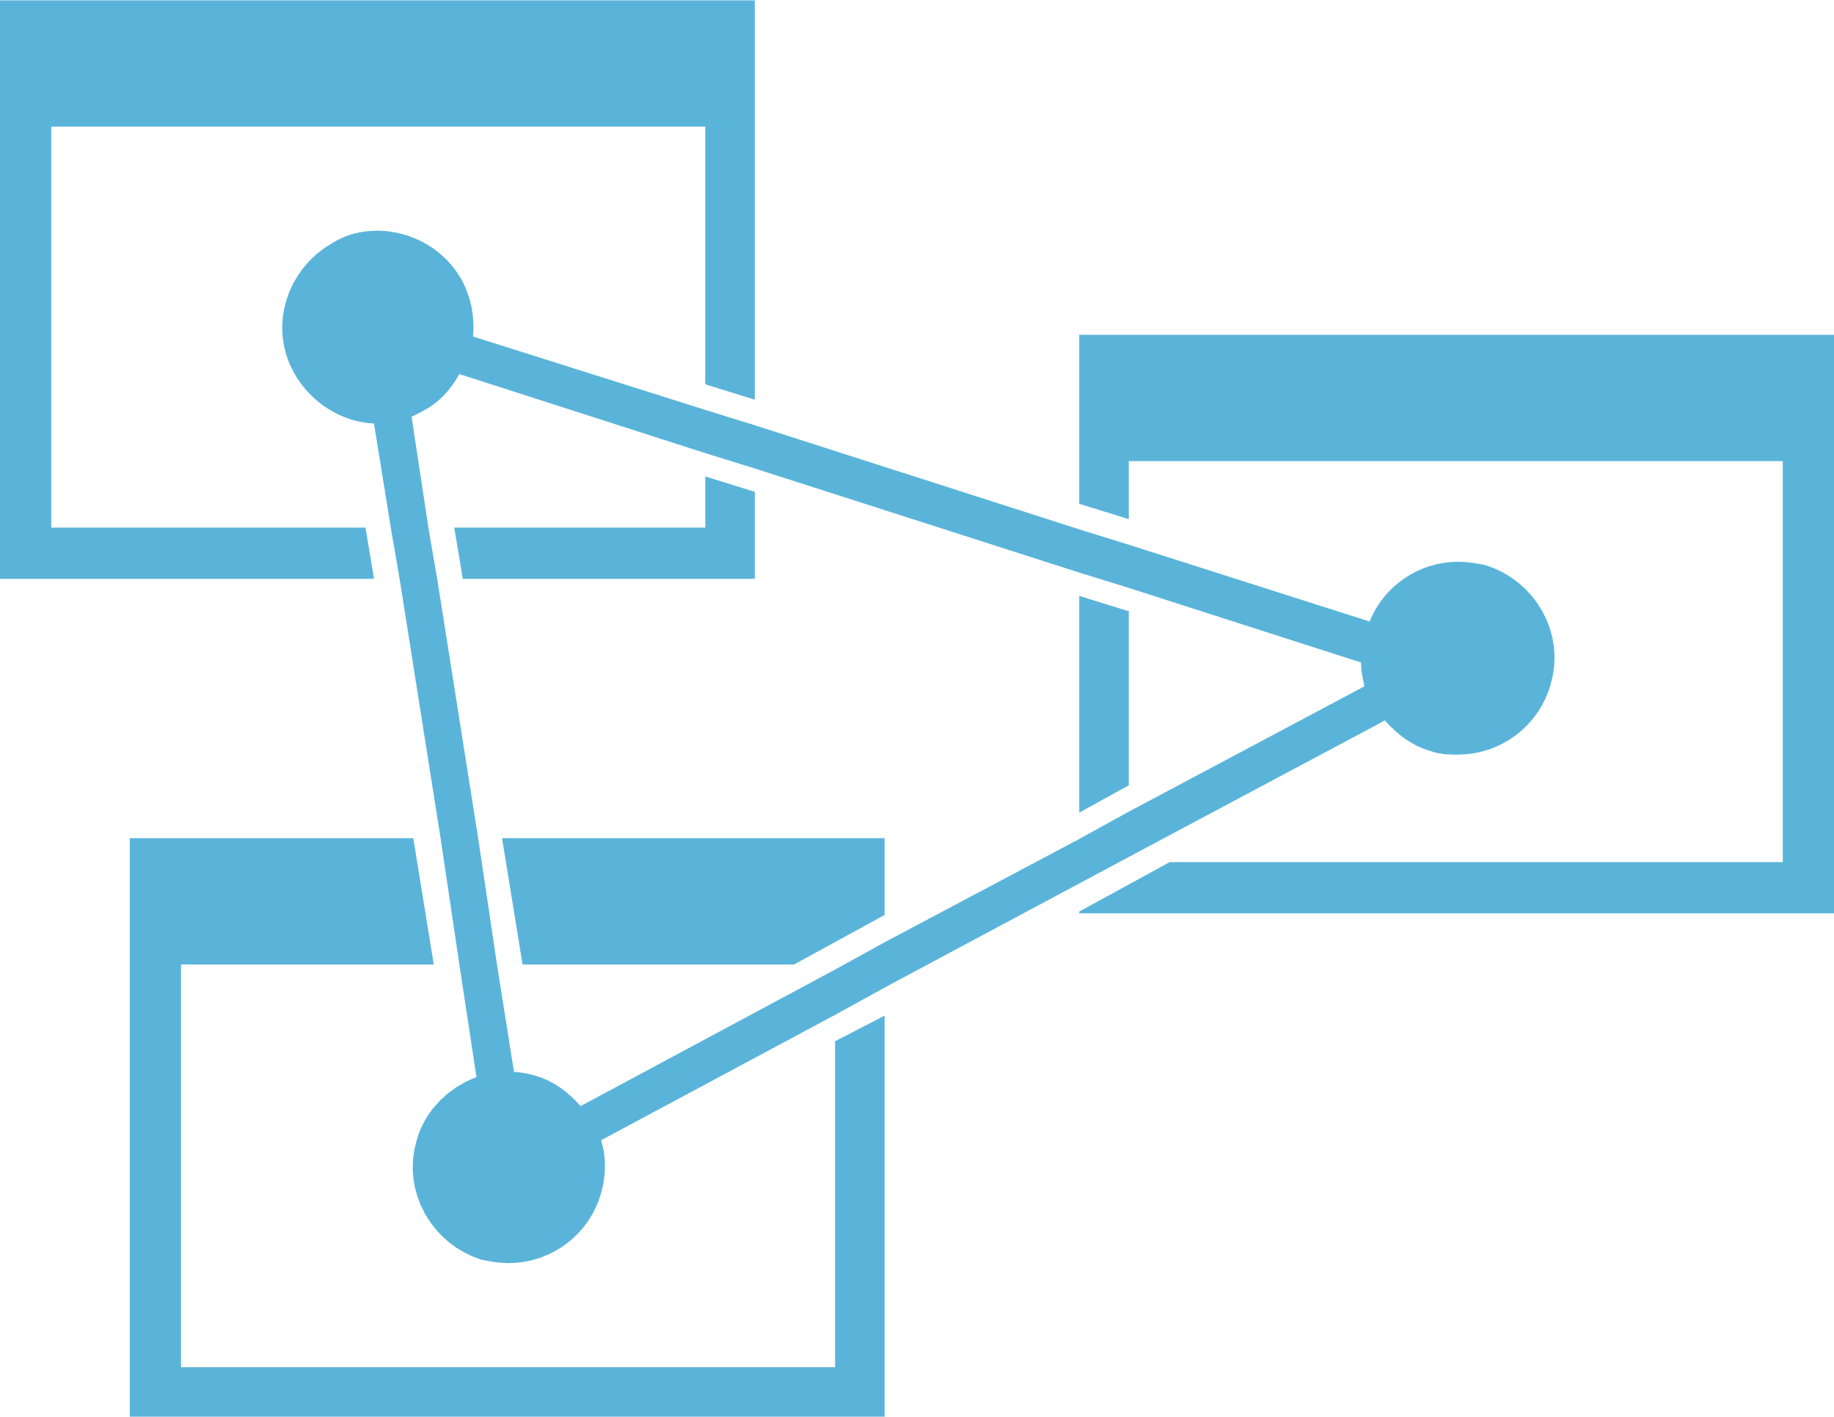



Advanced analytics pattern in Azure
Performing data collection/understanding, modeling and deployment
MODEL TRAINING
SERVING STORAGE
SYNAPSE ANALYTICS
(Spark Pool)
AZURE DATABRICKS (Spark ML)
AZURE ML COMPUTE
DATA SCIENCE VM
SENSORS AND IOT
(UNSTRUCTURED)
COSMOS DB
LONG TERM STORAGE
DATA PROCESSING
APPLICATIONS
SQL DB
r
LOGS, FILES AND MEDIA (UNSTRUCTURED)
SQL DB
AZURE ML COMPUTE
SYNAPSE ANALYTICS
(SQL / Spark Pool)
SYNAPSE ANALYTICS
(SQL Pool)
DATA LAKE STORE
AZURE STORAGE
COSMOS DB
AZURE DATABRICKS
ORCHESTRATION
TRAINED MODEL HOSTING
AZURE ANALYSIS SERVICES
BUSINESS / CUSTOM APPS
(STRUCTURED)
SYNAPSE ANALYTICS
(SQL Pool)
DASHBOARDS
SYNAPSE ANALYTICS
(Pipelines)
AZURE KUBERNETES SERVICE
DATA FACTORY

Slide 7
Model deployment patterns in Azure
Performing data collection/understanding, modeling and deployment
MODEL TRAINING
TRAINED MODEL HOSTING
AZURE ML
Webservice on ACI OR AZURE KUBERNETES SERVICE
SENSORS AND IOT
(UNSTRUCTURED)
LONG TERM STORAGE
DATA PROCESSING
r
LOGS, FILES AND MEDIA (UNSTRUCTURED)
AZURE ML COMPUTE
SYNAPSE ANALYTICS
(SQL / Spark Pool)
APPLICATIONS
DATA LAKE STORE
AZURE STORAGE
COSMOS DB
SQL DB
AZURE DATABRICKS
ORCHESTRATION
BUSINESS / CUSTOM APPS
(STRUCTURED)
SYNAPSE ANALYTICS
(Pipelines)
DATA FACTORY

Slide 8
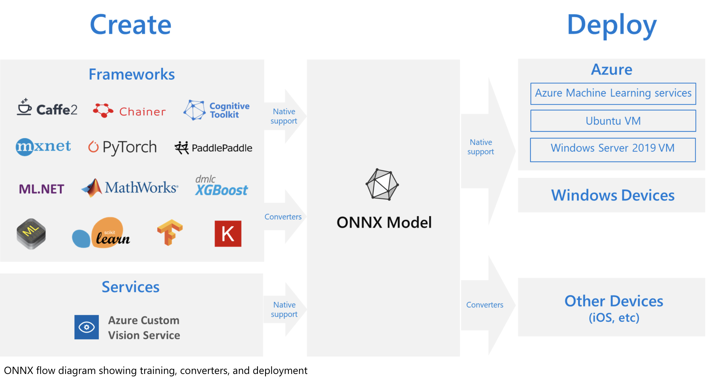
What is ONNX?
Notes:
The challenges of optimizing the performance of machine learning models in production is extremely hard considering the range of hardware capabilities on different platforms such as cloud vs edge, CPU vs GPU etc. and couple that with the variety of frameworks that available for building and training the machine learning models.
To support the idea of providing users the flexibility to train their machine learning models on framework of their choice, and run that model anywhere with optimal performance, is at the core of Open Neural Network Exchange (ONNX) format for representing machine learning models. ONNX is an open format, that is supported by a community of partners, including Microsoft, who create compatible frameworks and tools.
You can create ONNX models from many frameworks, including PyTorch, Chainer, Microsoft Cognitive Toolkit (CNTK), MXNet, ML.Net, TensorFlow, Keras, SciKit-Learn, and more. ONNX Runtime is optimized for both cloud and edge and works on Linux, Windows, and Mac, and it also integrates with accelerators on different hardware such as TensorRT on NVidia GPUs. ONNX models can be deployed to the cloud using Azure Machine Learning and ONNX Runtime. They can also be deployed to Windows 10 devices using Windows ML. They can even be deployed to other platforms using converters that are available from the ONNX community.
The interoperability you get with ONNX makes it possible to get great ideas into production faster. With ONNX, data scientists can choose their preferred framework for the job. Similarly, developers can spend less time getting models ready for production, and deploy across the cloud and edge.
Data scientists: use the framework of their choice to create and train models
Developers: deploy models cross-platform with minimal integration work

Slide 9
Tools for Machine Learning
Azure Machine Learning Studio
Visual Studio Code
Python SDK
Azure CLI

Slide 10
BRK02 – DEMO: The Azure Machine Learning Workspace
<Presenter name>
<Presenter title>

Slide 11
BRK03 – Introducing the Data Science process
<Presenter name>
<Presenter title>

Slide 12
Agenda
The Data Science Lifecyle
Relevant technologies
The ML Spectrum on Azure
The Data Science Process
The Notebook Paradigm
Tools and libraries for Data Science

Slide 13


Slide 14
As a developer is deep learning for you?
In the future, deep learning will not only be used by the specialists- researchers, graduate students and engineers with an academic profile- but will also be a tool in the toolbox of every developer, much like web technology today.
- Francois Chollet, Creator of Keras

Slide 15
What do you really need to know to do machine learning?
Computer Science
Domain Expertise
Math
There’s an argument being made that only data scientists can do ML because they come from the math side.
How many developers do you know that are actually bad at math?

Slide 16
Machine/Deep learning and math
Machine learning and deep learning exhibits comparatively little mathematical theory [compared to statistical analysis] and is engineering oriented.
It’s a hands-on discipline in which ideas are proven empirically more often than theoretically.
- Francois Chollet, Creator of Keras

Slide 17
How much math did we write in this code?
from keras import models
from keras import layers
network = models.Sequential()
network.add(layers.Dense(512, activation='relu', input_shape=(784,)))
network.add(layers.Dense(10, activation='softmax’))
network.compile(optimizer='rmsprop',
loss='categorical_crossentropy',
metrics=['accuracy’])
network.fit(train_images, train_labels, epochs=5, batch_size=128)

Slide 18
As a developer, what technologies do you need to learn?
Python
Azure Compute
Azure Storage
Azure Machine Learning

Slide 19
The Pre-Built and Custom AI Spectrum
Pre-Built AI
Custom AI
Azure Cognitive Services
Azure Machine Learning
Pre-built models
Custom models
Models are pre-trained using Microsoft supplied data
Models “customized” with your data
Models tailored to your scenario and your data

Slide 20
Azure Cognitive Services
Text Analytics
Personalizer
Computer Vision
Decision
Ink Recognizer
Translator Text
Bing Spell Check
Face
Language
Vision
Language Understanding
Content Moderator
Video Indexer
Custom Vision
Anomaly Detector
Content Moderator
Form Recognizer
QnA Maker
Bing Custom Search
Bing Video Search
Bing Entity Search
Conversation transcription capability
Bing News Search
Bing Local Business Search
Custom Speech
Web search
Speech
Bing Web Search
Speech transcription
Bing Image Search
Bing Autosuggest
Text-to-Speech
Bing Visual Search
Neural Text-to-Speech

Slide 21
Machine Learning as the new programming paradigm
Rules
Traditional Programming
Answers
Data
Data
Machine Learning
Rules
Answers
Let the machine figure out the rules based on history!

Slide 22
Behind Machine Learning is the the Data Science Process
Collect Data
Prepare Data
Train Model
Evaluate Model
Deploy Model
Re-train
Model
Notes:
Collect Data
Prepare Data
Perform data wrangling to get the data in a format suitable for analysis
Explore and understand the data
Identify or create the features needed for your model
Train Model
Select the algorithm
Prepare training, testing and validation data sets
Iteratively evaluate model to identify best performing version and sanity check outcome
Evaluate Model
Run the model thru a final exam using data from your validation data set and see how it performs
Deploy the Model
Package the model and dependencies up for deployment
Use it in a web service or within an API in an application
Measure the ongoing performance of the model
Retrain
As the data environment changes and affect model performance, retrain the model on fresh data

Slide 23
The Data Science Process (Developer Lens)
Collect Data
Prepare Data
Train Model
Evaluate Model
Deploy Model
Re-train
Model
Write Code
Write Queries & Code
Write Code Do some math
Write Code Do some math
Do DevOps

Slide 24
The Notebook Paradigm
Collect Data
Retrieve Files
Evaluate
Model
Test Performance
Query SQL Databases
Compare Models
Call Web Services
Validate Model
“Scrape” Web Pages
Visualize Performance
Execute arbitrary:
- Python code
- R code
- SQL queries
- Shell commands
Prepare Data
Explore Data
Deploy
Model
Export Model File
Validate Data
Prepare Job
Clean Data
Deploy Container
Featurize Data
Re-package Model
Notebook
(Jupyter, Azure Databricks)
Train Model
Prepare Training Set
Experiment
Test Model
Visualize Performance

Slide 25









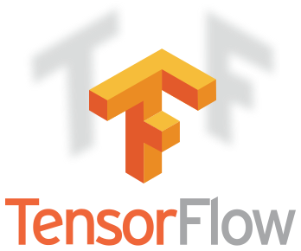




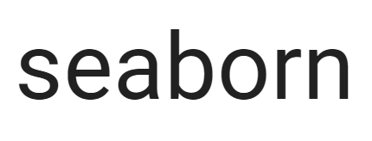







Examples of Tools for Data Science in the Wild
Core frameworks and tools
Machine Learning & Deep Learning
Keras
PyTorch
Visualization
Natural Language Processing
NLTK
Stanford
Huggingface
TORCHTEXT

Slide 26
BRK04 – Using compute resources in Azure Machine Learning
<Presenter name>
<Presenter title>

Slide 27
Agenda
Compute Instance
Compute Clusters
Inference Clusters
Managed Compute
Environments
Pipelines
GPU and FPGA Compute
Serverless/Azure Functions/App Service Integration
Support for NVIDIA Triton

Slide 28
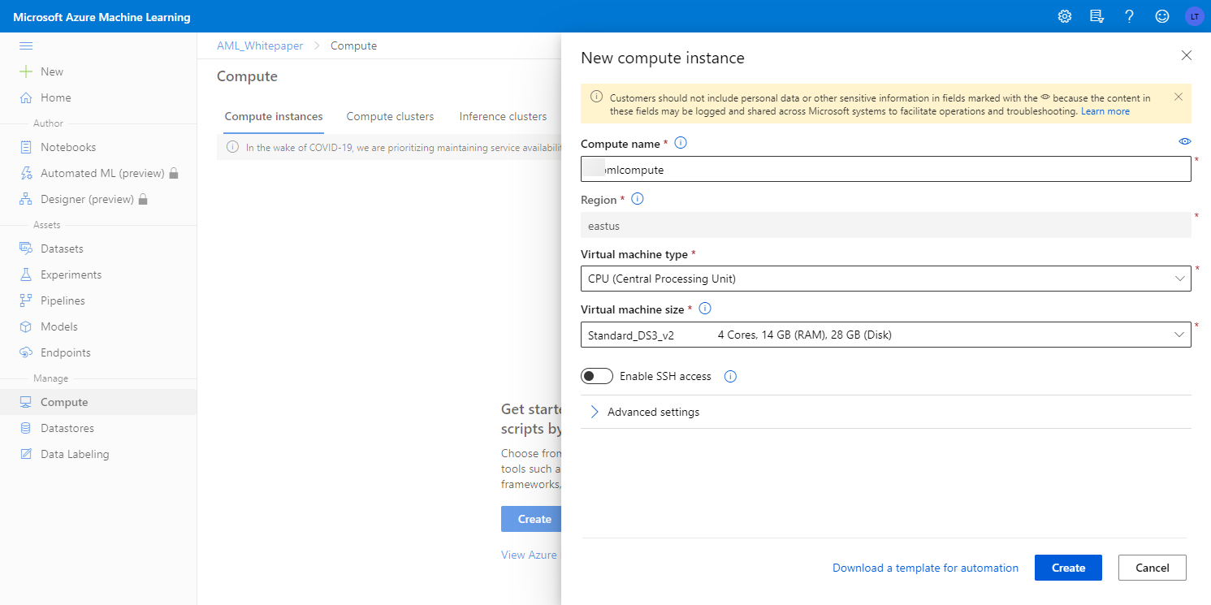
Compute Instances

Slide 29
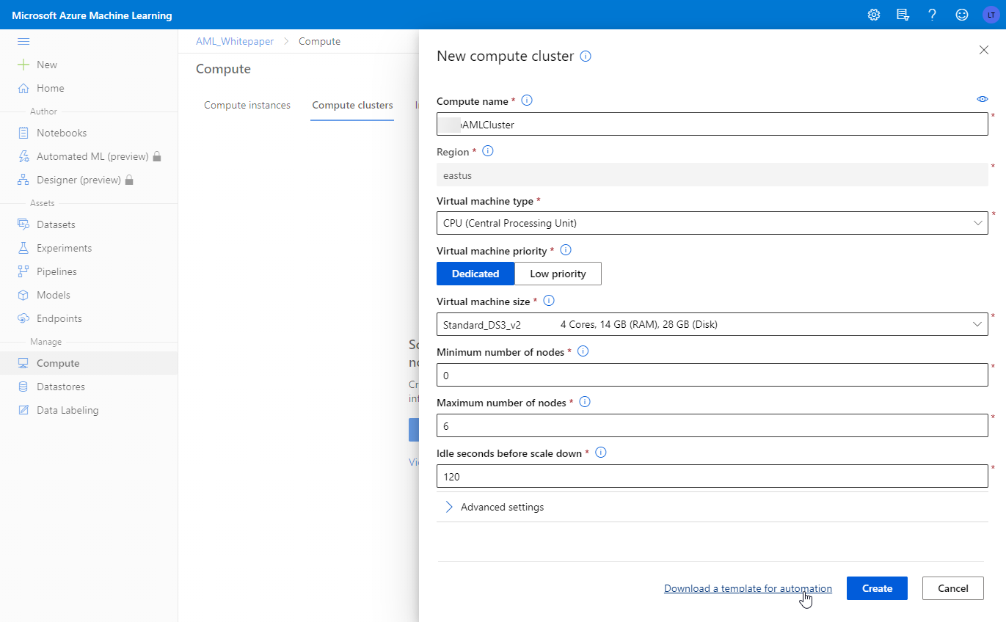
Compute Clusters

Slide 30
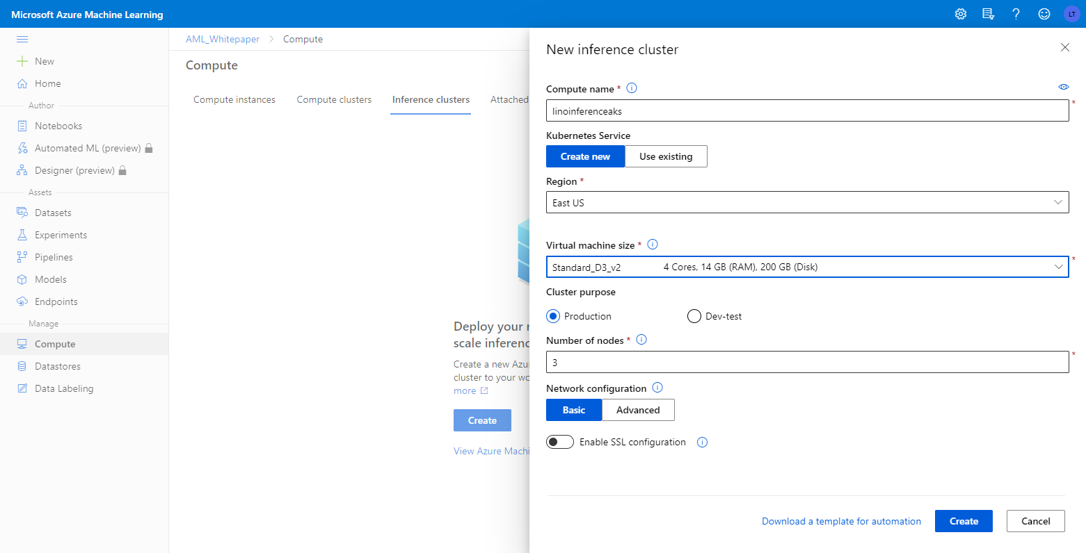
Inference Clusters

Slide 31
Managed Compute (new)

Slide 32
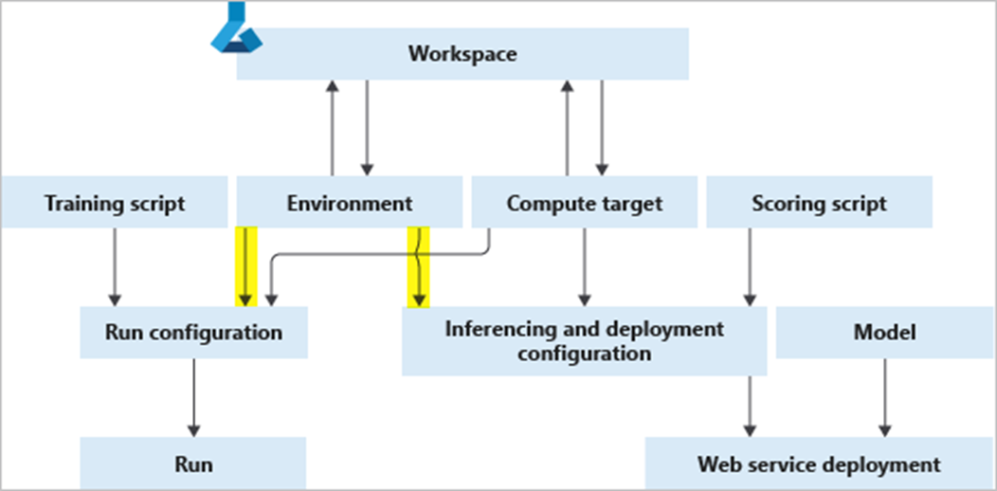
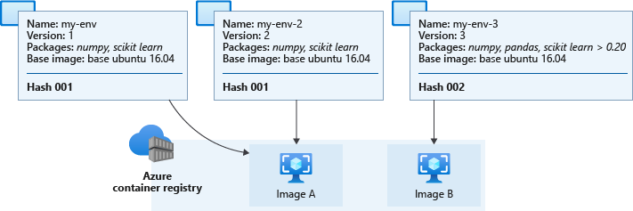
Azure Machine Learning environments
Reusable across training and scoring
Three types:
Curated
User-managed
System-managed (default)
Materialized as Docker images in the workspace ACR
Cached and reused

Slide 33
ML Pipelines
Define a repeatable, parameterized workflows for a machine learning task
Built-in PipelineStep Examples
Auto ML
Command (command line)
Data Transfer
Estimators (model training)
Hyperparameter Tuning
Python Script
R Script
Synapse Spark (Pyspark script)
…others
Example ML Pipeline
Clean, Prep, Train
Each step can execute pre-built modules or custom scripts
Each step of a pipeline can be configured to allow reuse of its previous run results
Step: Clean Data
Step: Run Python Data Prep Script
Step: Estimator (Train Model)

Slide 34
BRK05 – Responsible AI and Machine Learning
<Presenter name>
<Presenter title>

Slide 35
Agenda

Slide 36
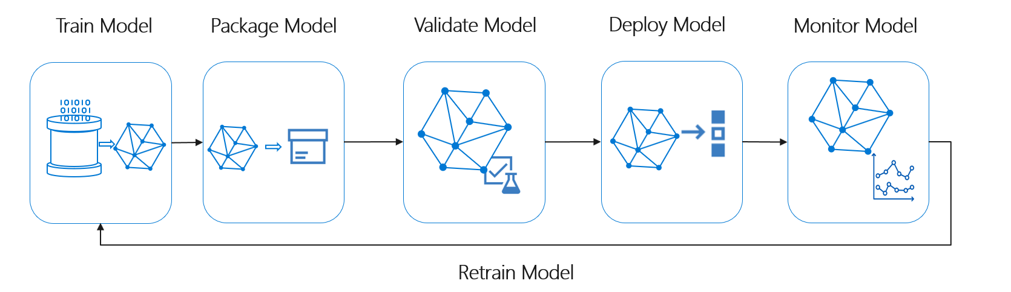
The Machine Learning Lifecyle

Slide 37
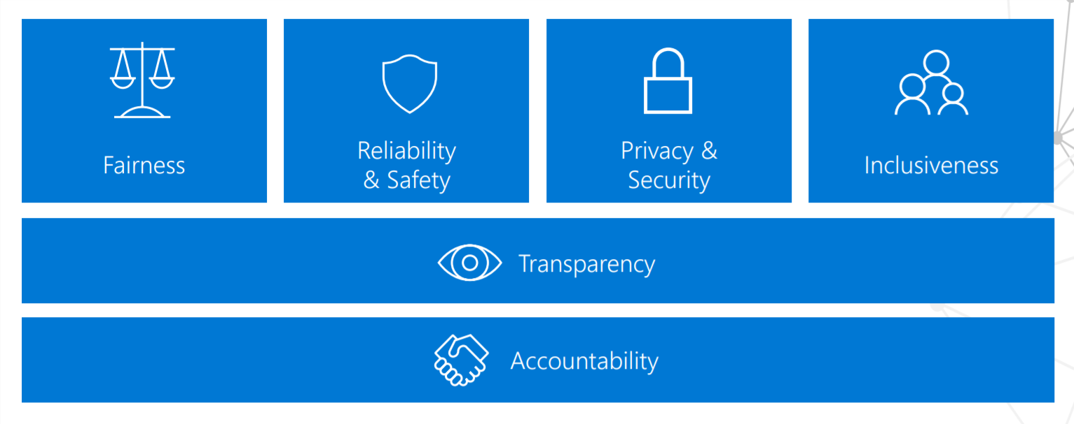
Responsible AI

Slide 38
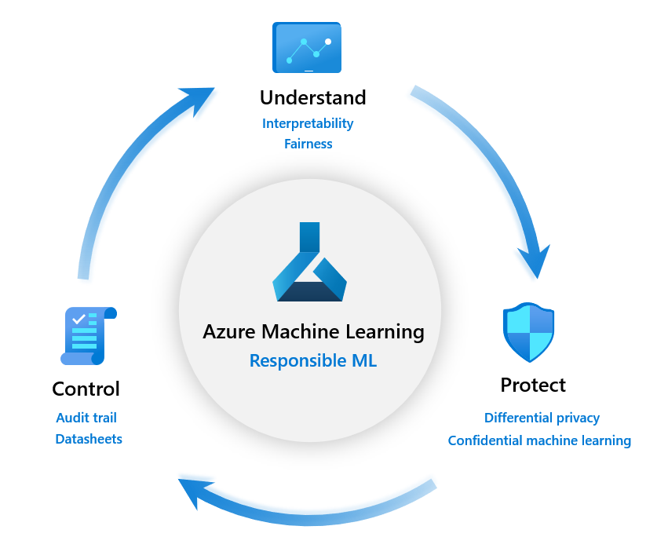
Responsible Machine Learning

Slide 39
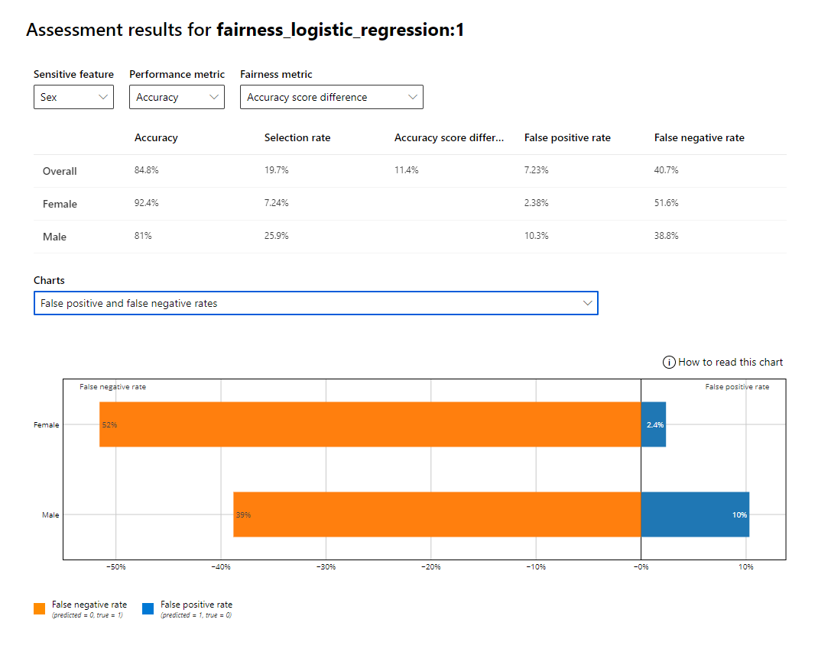
Fairlearn

Slide 40
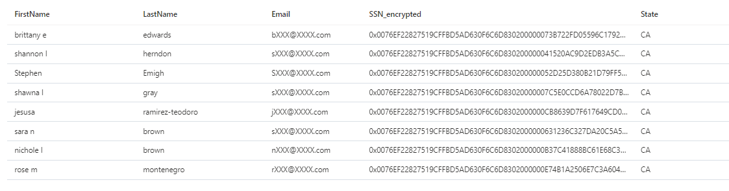




Approaches to Model Training with Sensitive Data
Masked / Obfuscated text
DATA SOURCE
Encrypted text
Plain text
Data encrypted at rest
Data encrypted in transit
Transparent Data Encryption
TRADITIONAL APPROACH
(unsupervised or supervised)
TLS
CANDIDATE APPROACHES:
In-place obfuscation
Column level encryption
TRAINING NOTEBOOK / SCRIPT
FEATURE SELECTION/ ENGINEERING
Dynamic data masking
Homomorphic Encryption
DATAFRAME
Disable MS telemetry collection
Row Level Security
limit to specific rows according to user’s role
TRAINING
Column Level Security
limit to specific columns
Use Log Analytics “workspace” instead of classic App Insights
Dynamic Data Masking
apply masking according to user’s role
MODEL
Differential Privacy
query implements privacy mechanisms that approximate the raw data

Slide 41
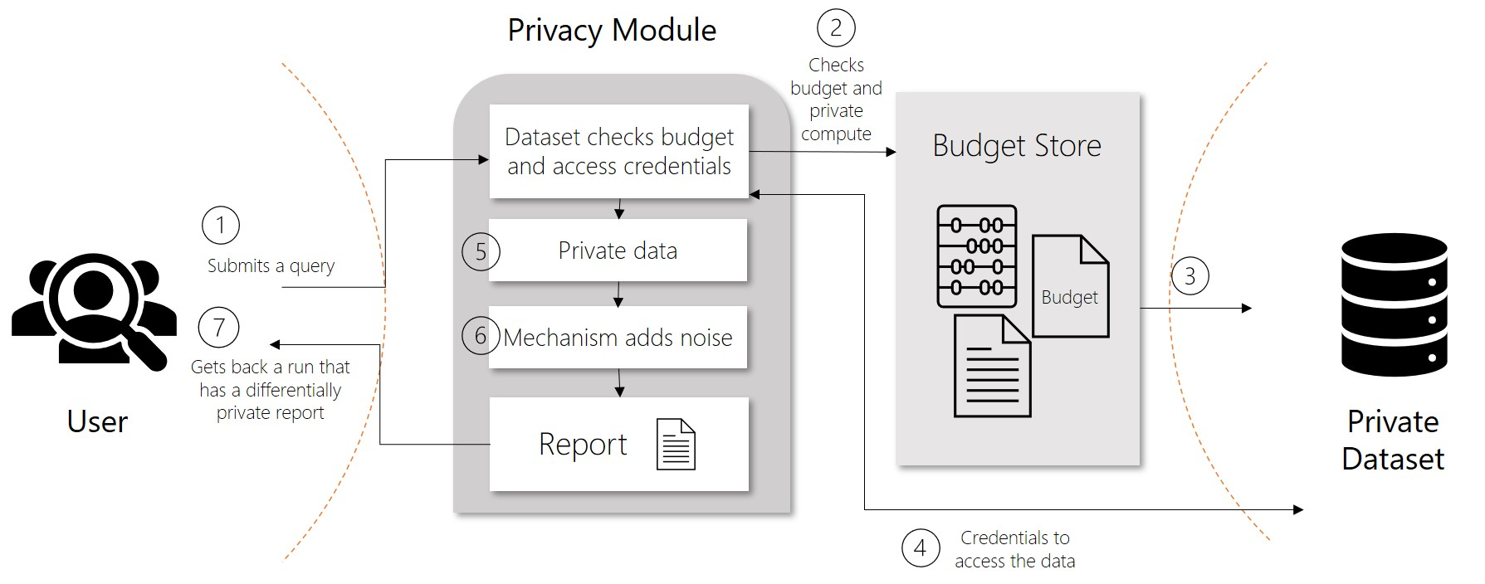
Differential Privacy
SmartNoise SDK

Slide 42

Model Training with Sensitive Data Using Differential Privacy
Differential Privacy Microservice
Budgeting
TRADITIONAL APPROACH
(CHANGED)
Approximation
RAW DATA IN SQL DB
APPROXIMATED DATA
SmartNoise SDK
TRAINING NOTEBOOK / SCRIPT
FEATURE SELECTION/ ENGINEERING
APPROXIMATED DATA IS “RELIABLE” WITHIN CONFIGURABLE BOUNDS
STRONG ASSURANCES AGAINST RECONSTRUCTION AND REIDENTIFICATION
APPROXIMATED DATA IS ROUGHLY THE SAME SIZE AS RAW DATA
DATAFRAME
TRAINING
REQUIRES APPROXIMATED DATA FOR INFERENCING
MODEL

Slide 43


Model Training with Sensitive Data Using Homomorphic Encryption
Encryption Privacy Microservice
Query
RAW DATA IN SQL DB
ENCRYPTED DATA
Data Encoding
TRADITIONAL APPROACH
(CHANGED)
Microsoft SEAL
KEYS IN AZURE KEY VAULT
TRAINNG NOTEBOOK / SCRIPT
COMPUTATIONS CAN BE PERFORMED ON ENCRYPTED DATA (i.e. for feature engineering)
REQUIRES CALLERS OF TRAINED MODEL TO PROVIDE ENCRYPTED DATA FOR PREDICTIONS
ONLY PUBLIC KEY OF KEY PAIR REQUIRED TO ENCRYPT DATA FOR INFERENCING
WORKS ONLY AGAINST REAL AND INTEGER DATA (TEXT NEEDS TO BE ENCODED)
ENCRYPTED DATA IS MUCH LARGER THAN RAW DATA
FEATURE SELECTION/ ENGINEERING
DATAFRAME
TRAINING
REQUIRES ENCRYPTED DATA FOR INFERENCING
MODEL
Notes:
Make sure to check: https://docs.microsoft.com/en-us/azure/machine-learning/how-to-homomorphic-encryption-seal

Slide 44
BRK06 – Securing an Azure Machine Learning Workspace
<Presenter name>
<Presenter title>

Slide 45
Agenda

Slide 46
Security checklist
Name | Description
Store training data | Ensure training data is stored with appropriate security.
Load training data | Ensure proper security is applied when connecting and reading from various data sources.
Prepare data | Ensure various intermediate forms and/or formats of data used in data preparation processes are stored securely (even if storage is temporary).
Manage datastores | In general, ensure access to various datastores is performed in a secure way. Avoid spreading datastore connecting credentials is source code, notebooks, config files, and the like. The recommended approach for Azure Machine Learning service is to use the register datastore capabilities for secure management of connections. Also, make sure you understand the data encryption features of Azure Machine Learning service.
Manage trained models | Ensure trained machine learning models are stored in a secure environment (e.g. the Azure Machine Learning service model registry with versioning). Ensure trained models are not save (and left there) in various compute environments used for training workloads.

Slide 47
Security checklist - continued
Name | Description
Deploy models for real-time scoring | Ensure models are deployed in secure environments. Ensure web service endpoints exposed for real-time scoring are properly secured and monitored for attempts to breach security (e.g. by using HTTPS, security keys vs. tokens, Azure AD integration etc...). Make sure you follow proper security guidelines for ACI or AKS.
Deploy models for batch scoring | Ensure models are deployed in secure environments. Ensure proper security of all actions capable of starting a batch processing job.
Manage secrets | Ensure secrets are not left in easily accessible places (source code files, source code repositories, notebooks, scripts etc...). Wherever possible, use approaches that do not require specifying credentials at run-time. Perform the task of regenerating storage account keys at regular intervals of time.
Manage workspaces | The Azure Machine Learning service is the main security boundary for controlling access to machine learning resources. Make sure you understand the security impact of an Azure machine learning workspace.
Manage networking | Secure AML training and scoring jobs using virtual networks.

Slide 48




Network security – AML workspace
Azure Machine Learning Workspace
Private endpoint
Service endpoint
STORAGE
ACCOUNT
or
KEY VAULT
Private endpoint
CONTAINER
REGISTRY
User client
Virtual Network

Slide 49
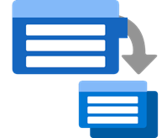

Network security - training and job submission environment
Azure Batch Service
Azure Machine Learning Workspace
Service tag batch/AML for inbound
Service endpoint
STORAGE
ACCOUNT
Private endpoint
Compute cluster
KEY VAULT
or
(Public)
Private endpoint
CONTAINER
REGISTRY
Compute instance
User client
Virtual Network

Slide 50





AML Pilot Architecture DEV Environment
APPLICATION INSIGHTS
KEY VAULT
STORAGE
ACCOUNT
MODEL TRAINING
MLOPS
AZURE ML COMPUTE
AZURE ML NOTEBOOKS
AZURE ML PIPELINES (Python Scripts)
AZURE
PIPELINES
GITHUB
(Repo)
AZURE ML (Experiments & Models)
DATA PROCESSING / SCORING
STORAGE
PRIVATE ENDPOINT
KEY VAULT
PRIVATE ENDPOINT
CONTAINER REGISTRY
PRIVATE ENDPOINT
AZURE ML NOTEBOOKS
AZURE ML PIPELINES (Python Scripts)
AZURE ML
PRIVATE ENDPOINT
SERVING STORAGE
CLIENT WORKSTATION
(Jump box, VPN or ExpressRoute)
SQL DB
DATA LAKE STORE

Slide 51
Network security checklist
Workspace secured
Training environment secured
Inferencing environment
Studio functionality secured
Firewall settings are in place
DNS name resolution is in place

Slide 52
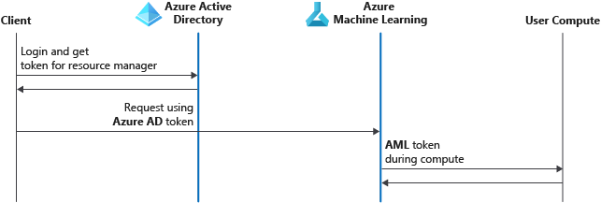
Access control - authentication

Slide 53
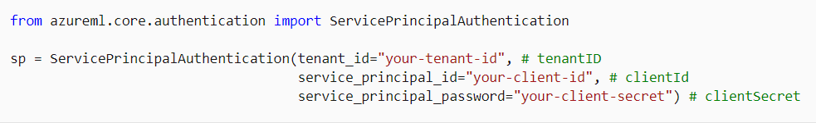
Access control – way to authenticate
Interactive
Service principal
Managed identity (via VM and SDK)

Slide 54
Access control - roles
Role | Access level
Reader | Read-only actions in the workspace. Readers can list and view assets, including datastore credentials, in a workspace. Readers can't create or update these assets.
Contributor | View, create, edit, or delete (where applicable) assets in a workspace. For example, contributors can create an experiment, create or attach a compute cluster, submit a run, and deploy a web service.
Owner | Full access to the workspace, including the ability to view, create, edit, or delete (where applicable) assets in a workspace. Additionally, you can change role assignments.
Custom Role | Allows you to customize access to specific control or data plane operations within a workspace. For example, submitting a run, creating a compute, deploying a model or registering a dataset.

Slide 55

Audit - Monitoring

Slide 56
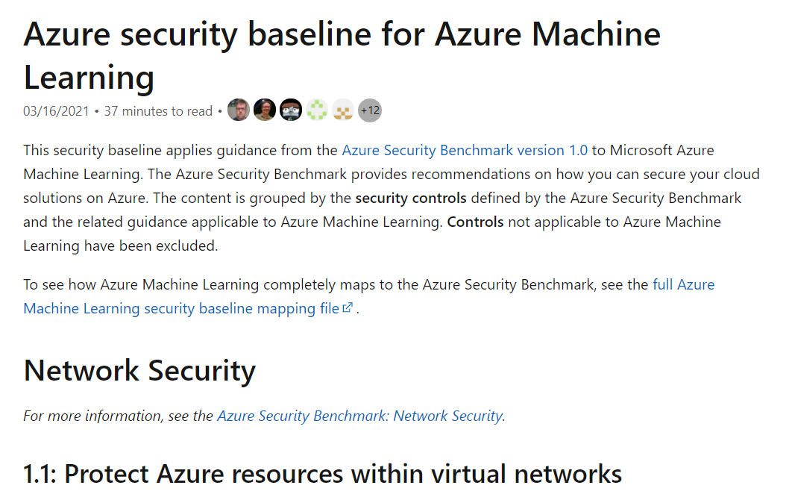
Security baseline for Azure Machine Learning
https://docs.microsoft.com/en-us/azure/machine-learning/security-baseline

